Slide 1
Synaptic Transmission
By: Nicole Phillips

Slide 2
Learning Objectives
Differentiate electrical and chemical synapses
Describe the step by step process of neurotransmitter release at chemical synapses
Explain the morphology of synapses and vesicles.
Differentiate types of postsynaptic receptors and how their activation contributes to neural communication

Slide 3
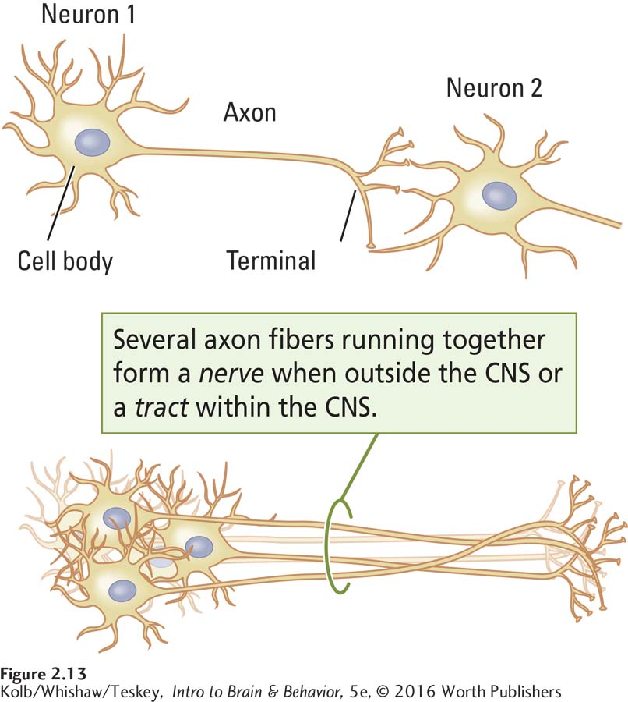

Slide 4
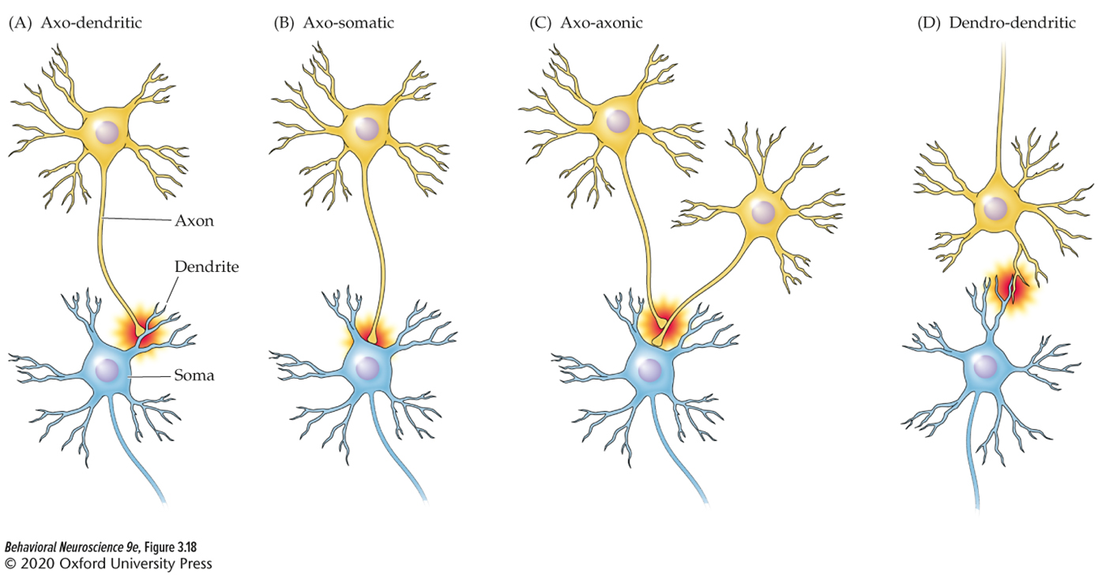
Types of synapses
Most common
Least common

Slide 5
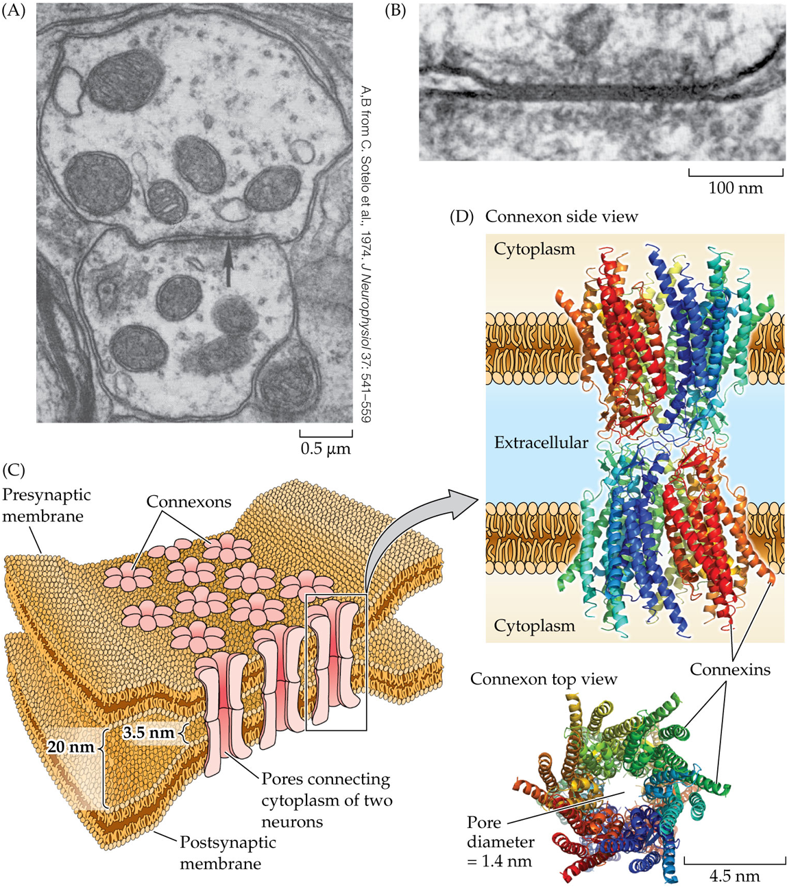
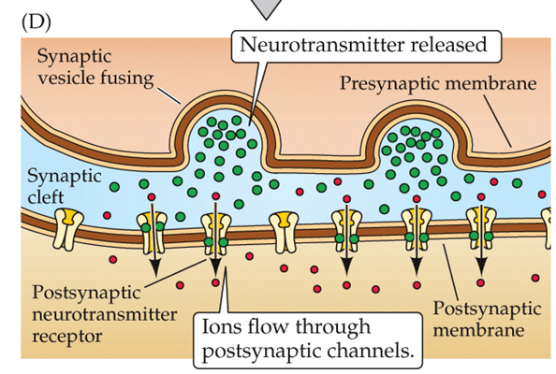
Two classes of synapses
Electrical synapse (aka gap junction): ions flow from one neuron directly to the other through connexons
Chemical synapse: chemicals are released into a synapse and then influence activity of receptors

Slide 6
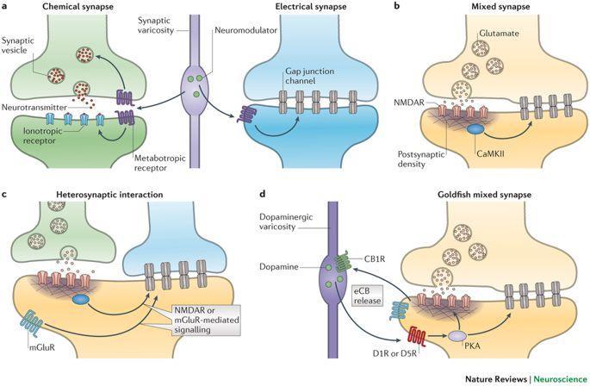
Just in case you thought through this might be straightforward…
Piedra et al., 2014, Nature Reviews Neuroscience
https://www.nature.com/articles/nrn3708

Slide 7
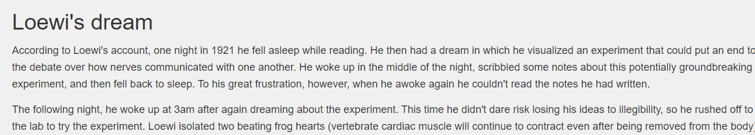
https://neuroscientificallychallenged.com/posts/history-of-neuroscience-otto-loewi

Slide 8
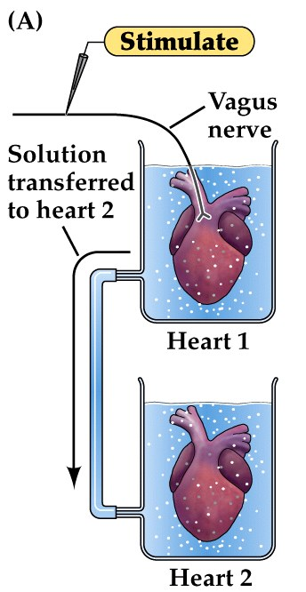
Key experiment Supporting the theory of chemical synapses
Otto Loewi (Physiologist), 1921
  Stimulation of the Vagus nerve attached to a heart (“donor”) causes the heart to slow
  Solution from donor heart was allowed to flow to a secondary unstimulated heart (“recipient”)
  Recipient heart slowed as well!
Loewi concluded that the electrical stimulation caused a chemical to be released into the fluid that could flow to the recipient chamber
He called the chemical “vagusstoff”
Today we know this chemical as:
acetylcholine

Slide 9
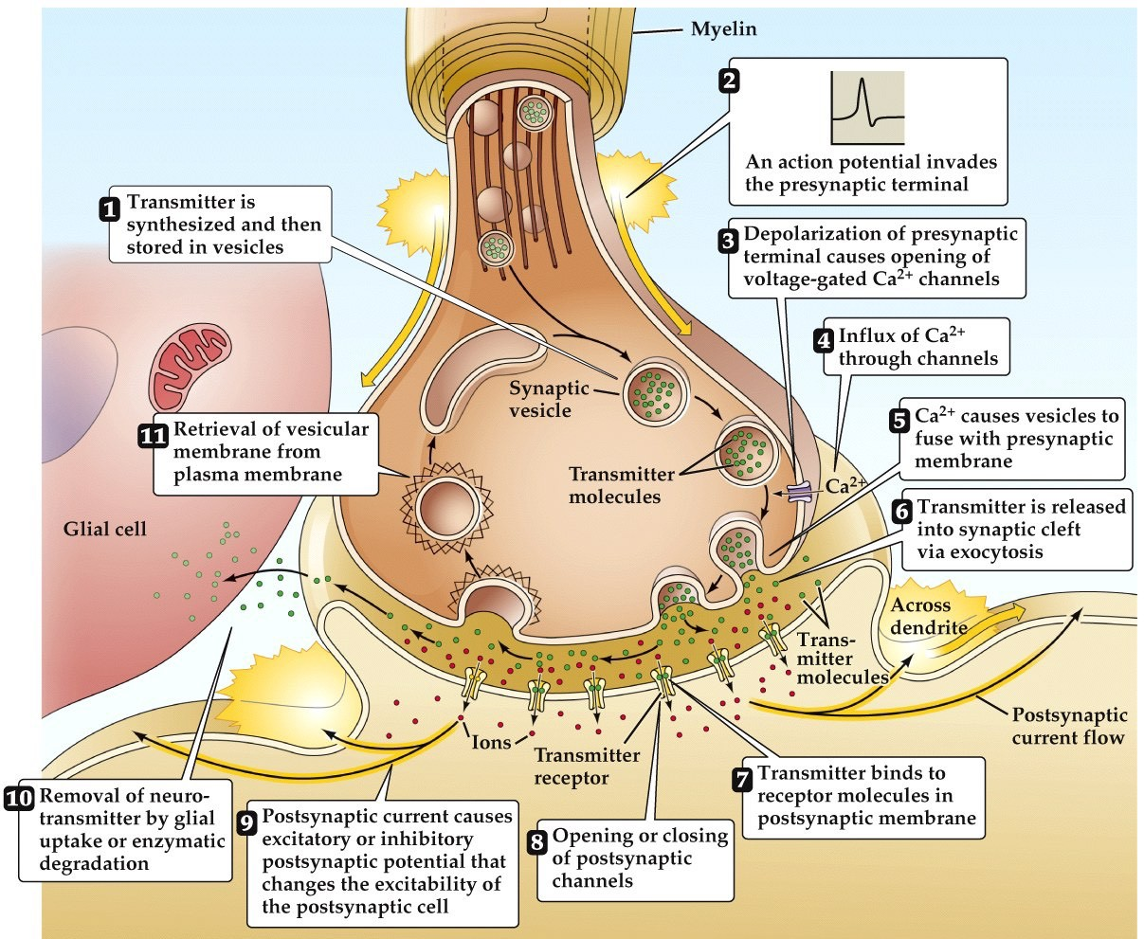
Chemical Synaptic Transmission
Step 1:
Neurotransmitters are synthesized and stored in vesicles

Slide 10
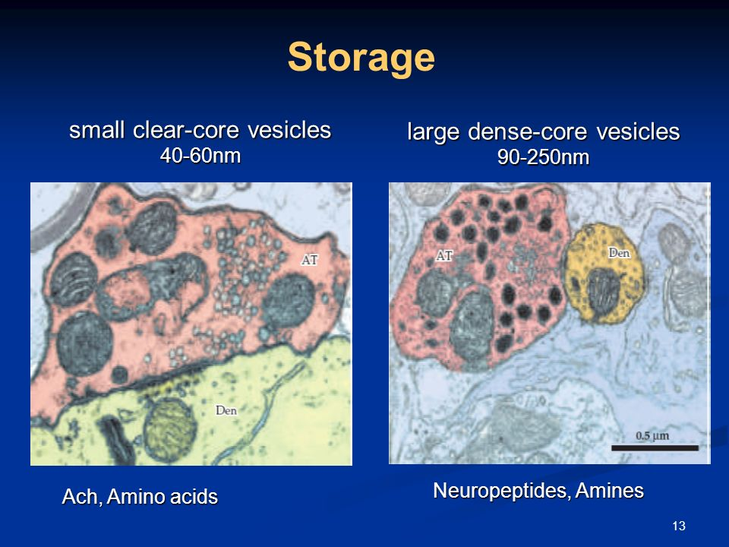
Neurotransmitters
a chemical substance that is released at the end of a nerve fiber by the arrival of a nerve impulse and, by diffusing across the synapse or junction, causes the transfer of the impulse to another nerve fiber, a muscle fiber, or some other structure (from Oxford dictionary).
> 100 neurotransmitters have been identified
2 Broad categories:
  Small-molecule neurotransmitters:
    tend to mediate rapid synaptic actions
    synthesized in the presynaptic terminal
    Packaged in 40-60 nm vesicles (small clear-core vesicles)
  Neuropeptides:
    tend to mediate slower, ongoing synaptic functions
    Synthesized in the cell body & transported down the axon (axonal transport)
    Packaged in 90-250 nm vesicles (large dense-core vesicles)

Slide 11
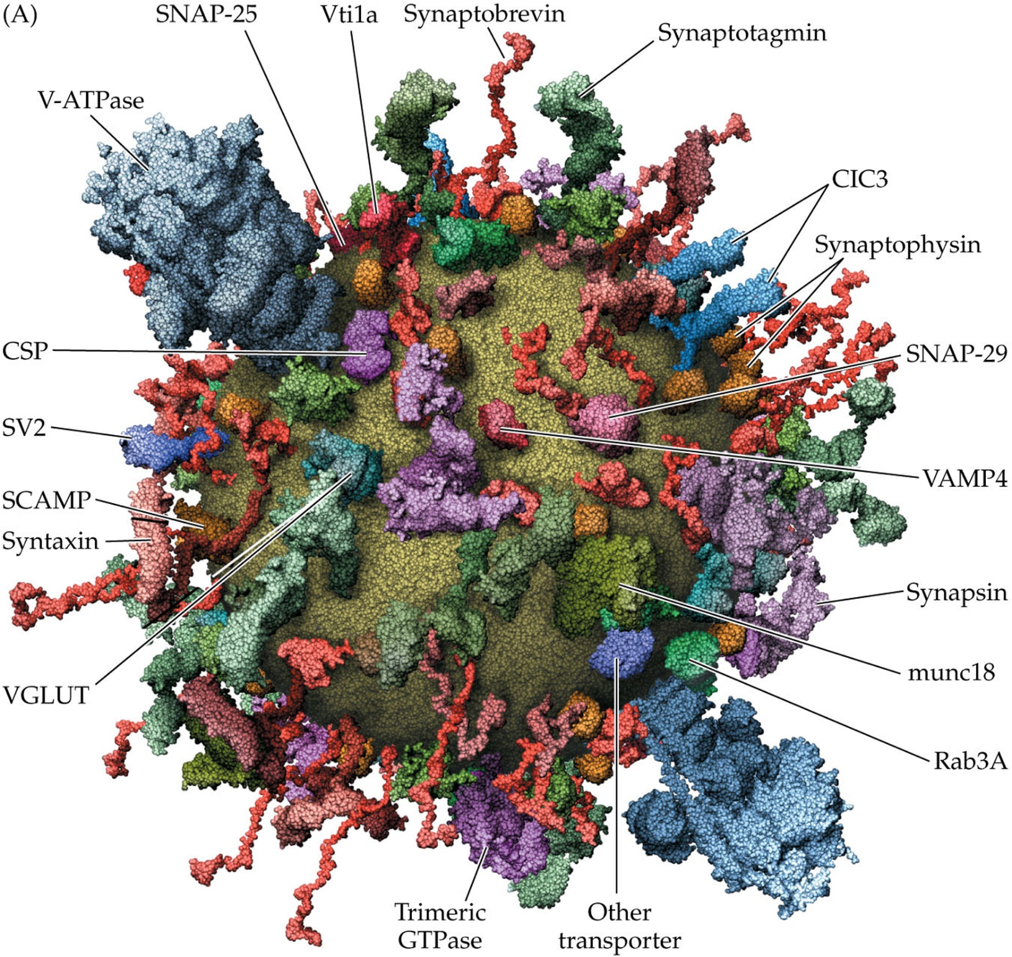
The molecular organization of a synaptic vesicle

Slide 12
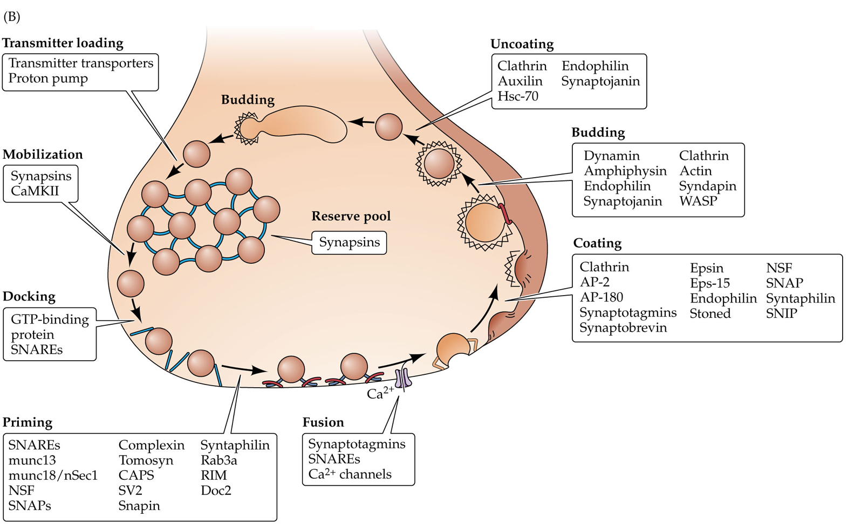
Vesicle Trafficking cycle

Slide 13
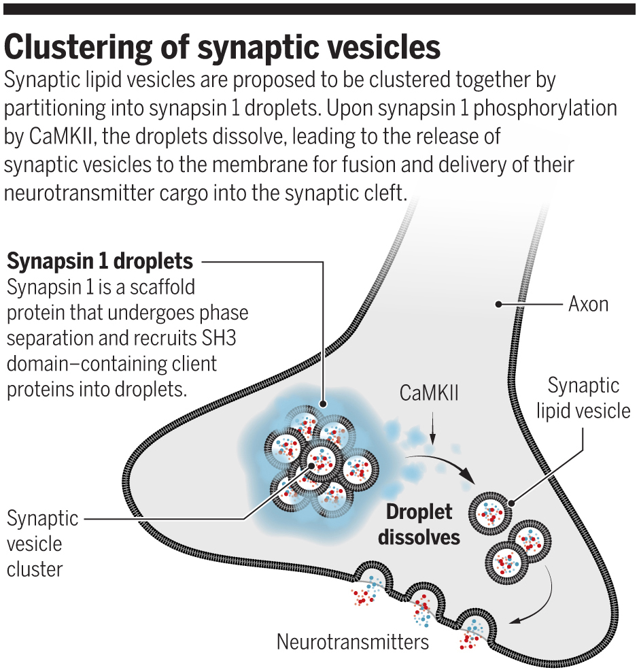
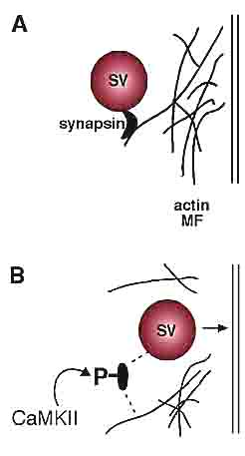
Synaptic vesicles are held in a “reserve pool”
  They are held there by synapsin
  BEFORE the AP, arrives they need to be mobilized for release
  calcium/calmodulin-dependent protein kinase II (CaMK-II) phosphorylates synapsin to release the vesicles from the pool
https://science.sciencemag.org/content/361/6402/548/tab-figures-data
https://www.bioscience.org/2001/v6/af/A643/figures.htm

Slide 14
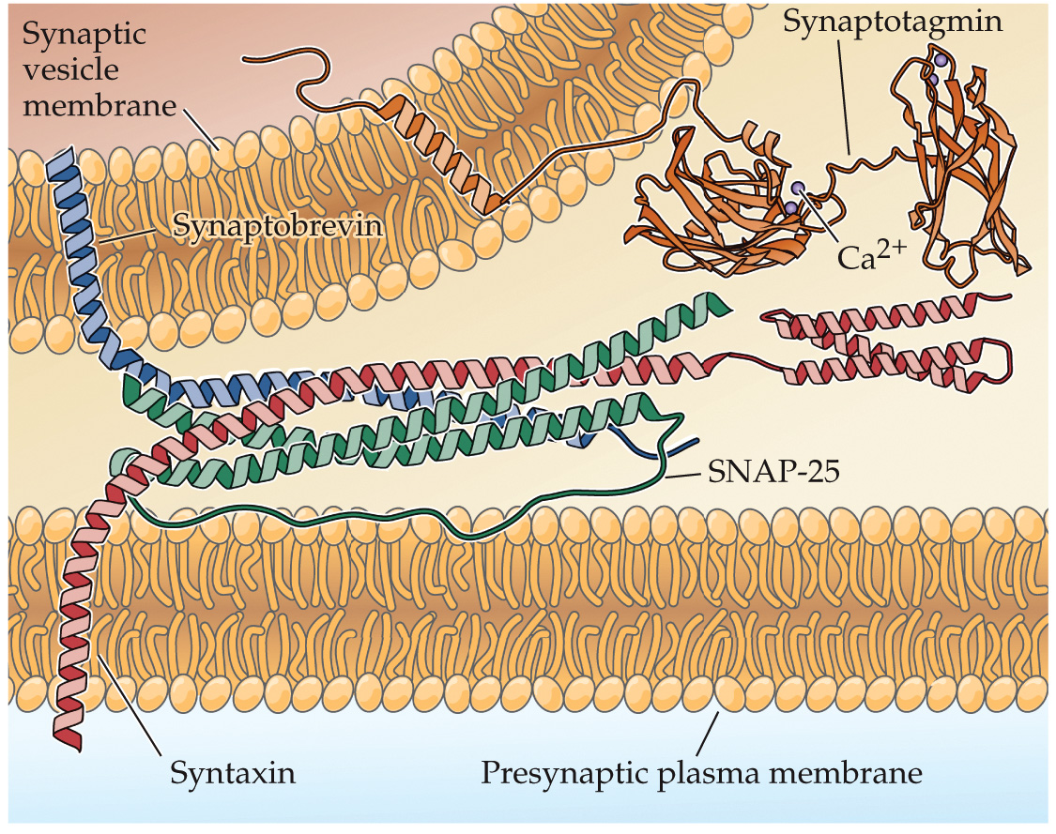
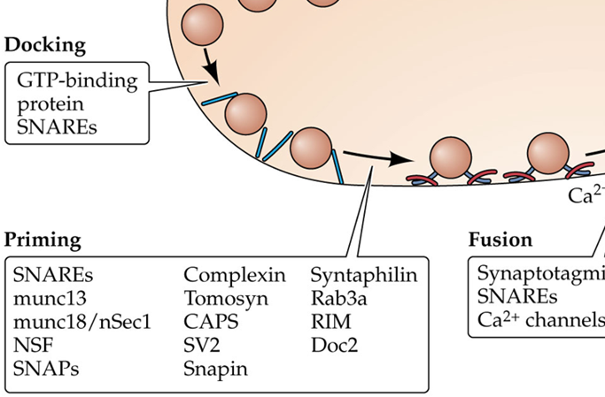
Vesicles need to be docked & primed for release
Docking: Bringing the vesicle close to the presynaptic membrane
    Vesicle (v-) SNARE
      Synpatobrevin (blue)
    Target (t-) SNAREs
      Syntaxin (red)
      SNAP-25 (green)
Priming: Assembling the SNARE protein complex

Slide 15
Steps 2-5
Action potential arrives at the axon terminal
Voltage gated Calcium channels in the membrane open
Influx of Calcium
Calcium binds with synaptotagmin on vesicles causing them to fuse with the presynaptic membrane.

Slide 16
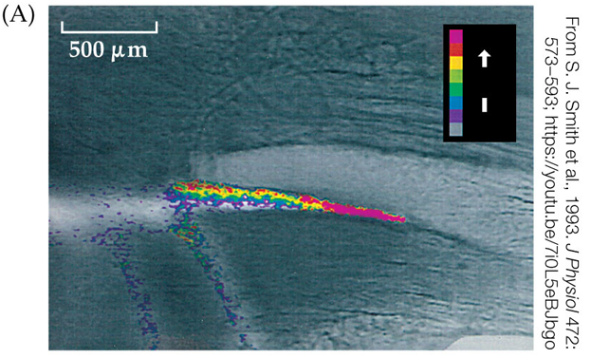
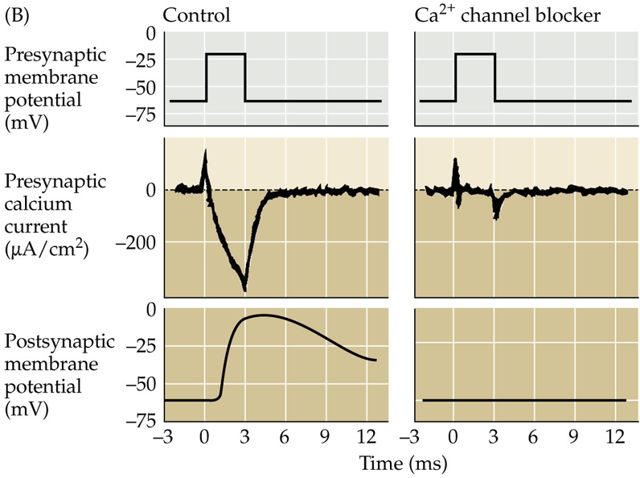
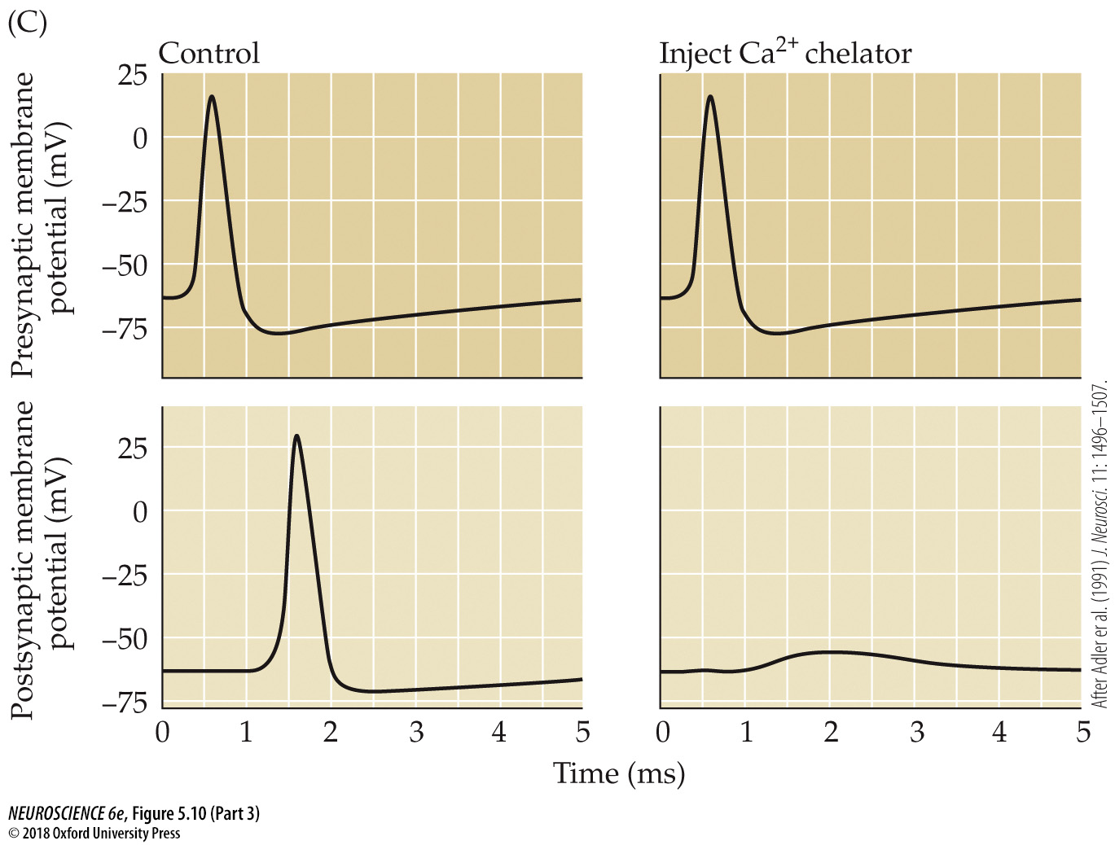
How do we know Ca2+ is the catalyst?
Stimulation of the presynaptic axon terminal increases levels of Ca2+
Ca2+ injection in the presynaptic neuron leads to a change in the postsynaptic neuron
No presynaptic response when Ca2+ channels are blocked
Injection of BAPTA (Ca2+ chelator) prevents a postsynaptic response

Slide 17
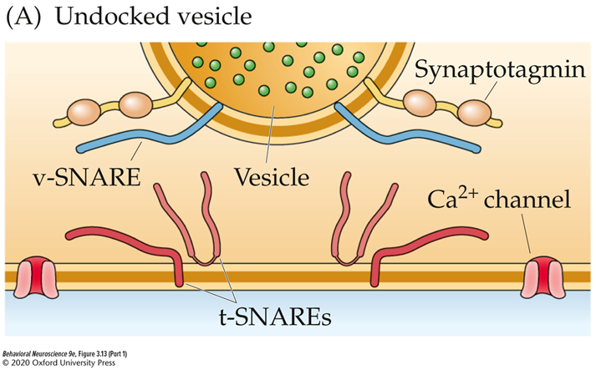
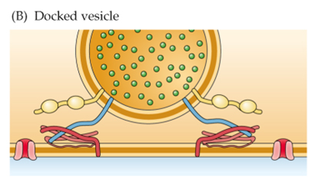

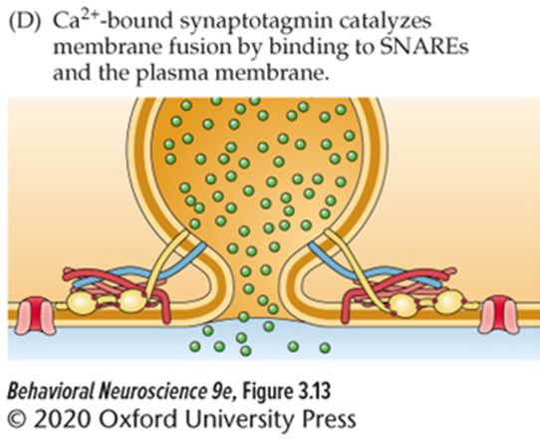
Synaptotagmin: the Ca2+ sensor
  When synaptotagmin binds Ca²⁺ ions:
    It integrates into the SNARE complex
    Initiates fusion of the vesicle and membrane
    A pore is formed to allow for NT release from the vesicle

Slide 18
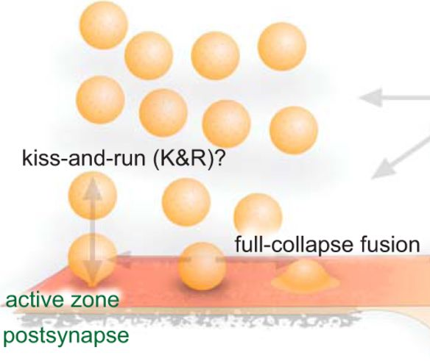
2 primary NT release modes
Full fusion
  Terminal and vesicle membranes fully merge and flatten.
  Requires complete exocytosis
Kiss-and-Run
  Vesicle content exits through a fusion pore.
  Quickly disconnects after NT release

Slide 19
Summary
Synapses can be electrical or chemical (or a little bit of both!)
Electrical synapses allow ions (and other molecules) to flow directly from one neuron to another through connexons.
Chemical synapses release neurotransmitters into the synapse.
A neurotransmitter can either be small molecule or neuropeptide
Vesicles are membrane bound sacks that are filled with NTs
Proteins on the vesicle and embedded in the presynaptic membrane drive the vesicle trafficking cycle.
Arrival of an AP at the axon terminal opens voltage gated Ca²⁺ channels.
Ca²⁺ binds with synaptotagmin initiating vesicle fusion with the presynaptic membrane.

